Slide 1
House price prediction regression and DL NN Model
Fliprobo.com

Slide 2
Problem statement and solution
Problem
The problem that we will look at in this tutorial is the house price dataset of USA.
The dataset describes 81 ( numerical + categorical ) properties of houses in Boston suburbs and is concerned with modeling the price of houses in thousands of dollars. As such, this is a regression predictive modeling problem.
This is a well-studied problem in machine learning. It is convenient to work with because all of the input and output attributes are numerical and there are 1460 instances to work with.
Performance for models evaluated using Mean Squared Error (MSE)
Then a complete DL NN model is built on the cleaned (X,Y) data that we get from ML model before feeding it to model building process and compare both the ML and DL model.
Solution
We will build a ML model to predict the price of the house which the company can refer to while investing in any future projects in Australia.
From this model the company will be able to know the returns from a particular property in the given period of time.

Slide 3
Choosing the evaluation metrics
As this is a pure regression problem we are using r2_score as our evaluation metrics and,
RMSE(root_mean_squared_error) as our error calculating parameter.

Slide 4
Steps for ML model
1)EDA by sweetviz library.
2)Dtale library implementation just for seeing.
3)Finding missing values.
4)Replace the missing values with '1' & '0' if value is present.
Plotting some diagram to see the relationship between the missing value and the target variable.
5)MIssing value treatment
6)Feature generation of temporal features.
#Deleting the feature that we have extracted our feature from.
7) Handling rare/sparse categorical features
# Encoding(categorical to numerical)-->Label encoder
# Segregating target(label) and independent features
8) Applying MinmaxScaler.
9) PCA with scree plot
10)Kewness treatment by PowerTransformer(method='yeo-johnson')
11)Saving the X,Y dataset for future use of this cleaned data in DL NN.
12) Applying algorithms here, And checking scores.
13) Finding best random state for all the algorithms
14) GridsearchCV on top 2 permorming models
15) Cross validating the model.
16) Saving the final model Linear Regressionin joblib-->’housepriceprediction.obj'
17) Loading the model
18) Testing the model on test data.
19) Saving final predictions in file.csv format
20) Conclusion

Slide 5
Steps for DL NN model
1) Import the cleaned data from ML model notebook.
2) X,Y are independent and dependent features.
3) Splitting the data.
4) Sequential Model structure development.
5) Predictions
6) Compile the model
7) Fit the model.
8) Evaluate the model
9) Coclusion

Slide 6
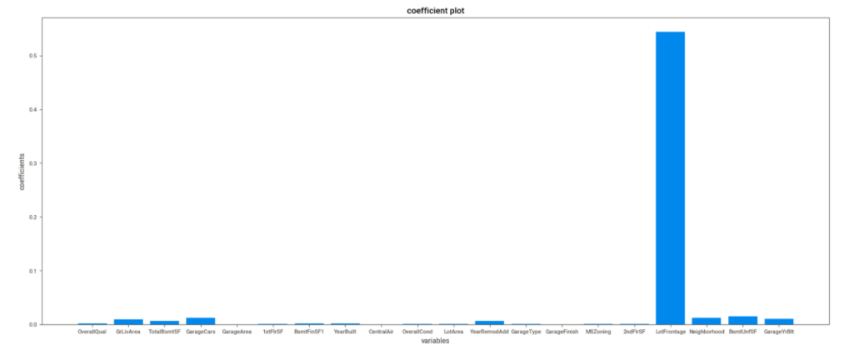
Visualization
Features affecting the price of the house

Slide 7
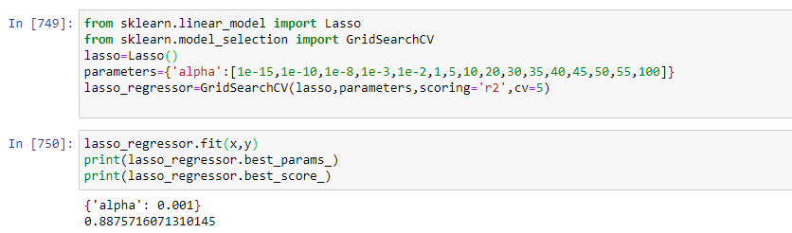
lasso_regressor model + hypertuning

Slide 8
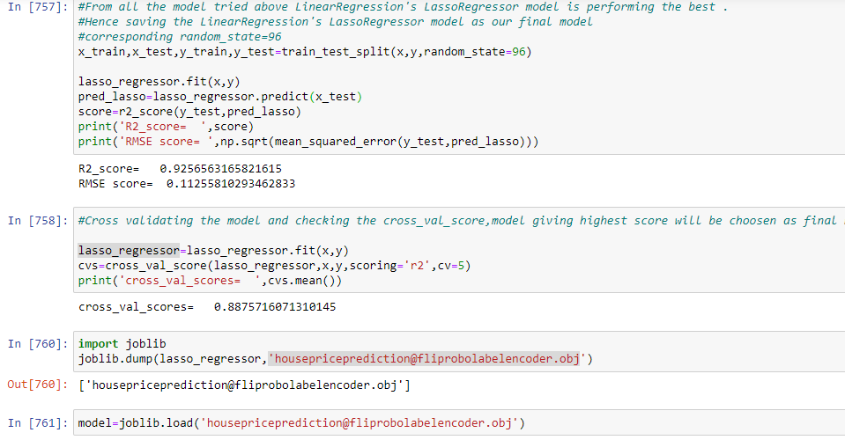
Choosing the final model
Choosing the Linear regression’s Lasso model because the model has the highest r2_score and minimum rmse score in comparision to other models.

Slide 9
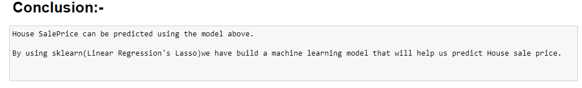
conclusion
Hence This model can surely help to us save some revenue of the company. It can help us analyze the data of USA , so that we can invest in australia efficiently .
“Money saved is money earned”.
. Thank You

